Slide 1
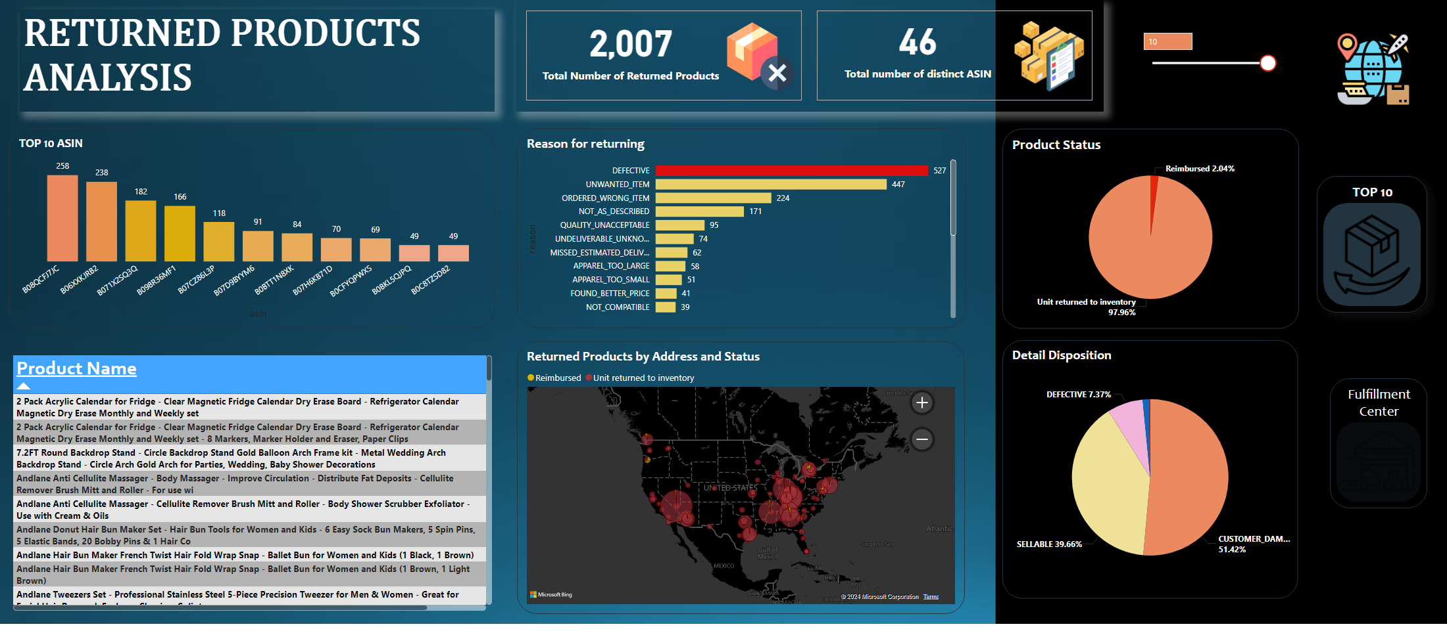
Returned Products Analysis
Notes:
slicer
No alt text provided
tableEx
No alt text provided
Reason for returning
No alt text provided
Product Status
No alt text provided
Detail Disposition
No alt text provided
cardVisual
No alt text provided
Returned Products by Address and Status
No alt text provided
TOP 10 ASIN
No alt text provided
image
No alt text provided
textbox
No alt text provided
Fulfillment Center
No alt text provided
TOP 10
No alt text provided

Slide 2
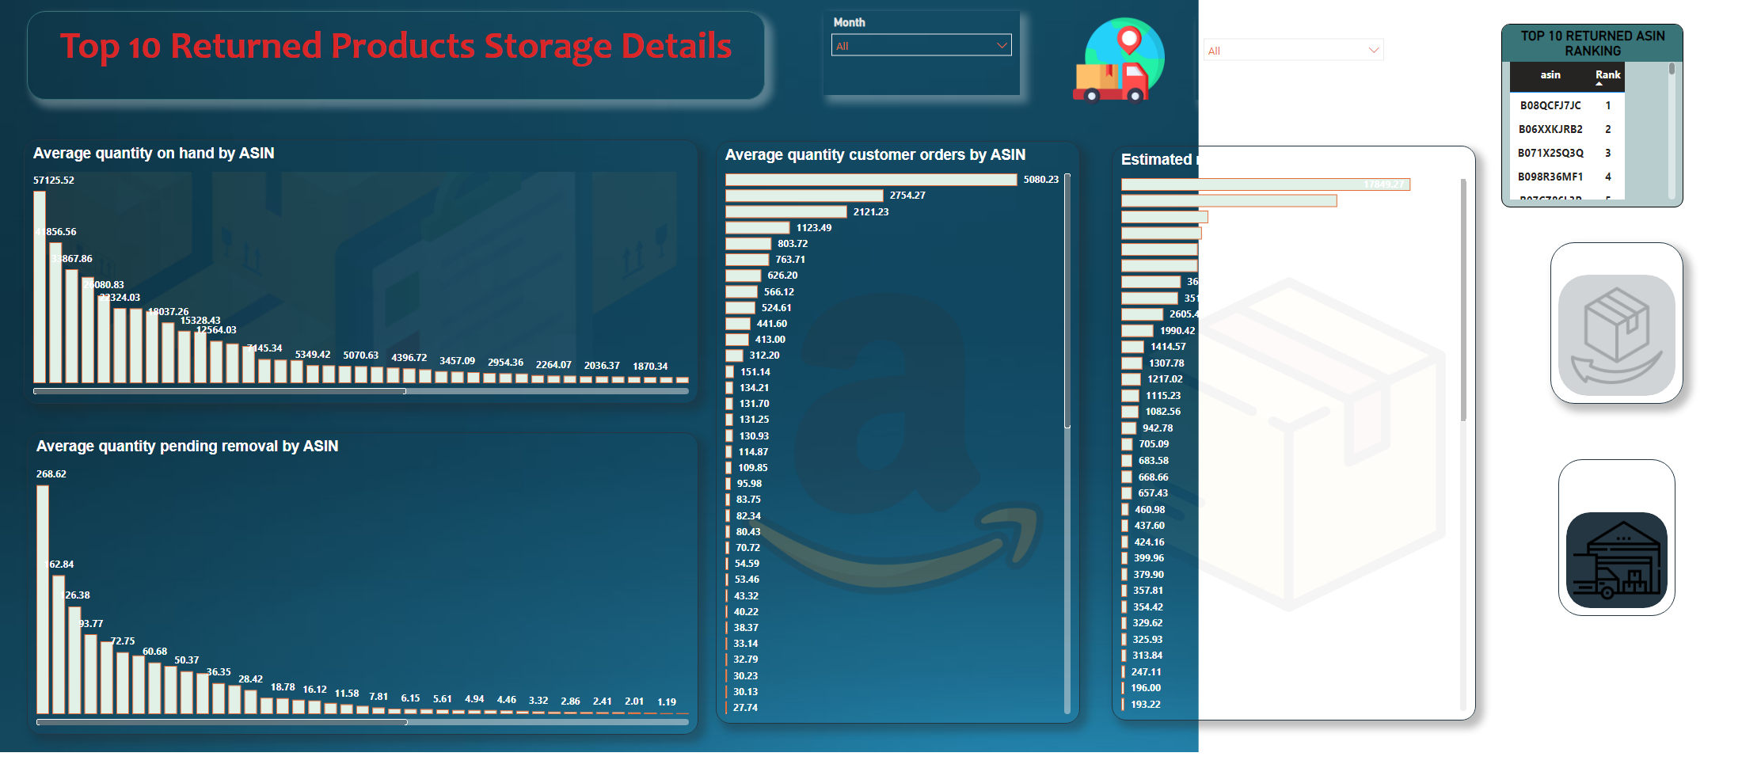
Top 10 FC Details
Notes:
Average quantity pending removal by ASIN
No alt text provided
Average quantity customer orders by ASIN
No alt text provided
Estimated monthly storage fee by ASIN
No alt text provided
Average quantity on hand by ASIN
No alt text provided
slicer
No alt text provided
slicer
No alt text provided
TOP 10 RETURNED ASIN RANKING
No alt text provided
textbox
No alt text provided
image
No alt text provided
TOP 10
No alt text provided
Fulfillment Center
No alt text provided

